Slide 1
How Has The Departure of the Crows Impacted Water Quality in the UWB Wetlands?
2025 Research Project
Course ID: BES 303
Date: 3/11/2025
Members: Patrick NG, Jacob Tuaua, Caleb Tarleton, Jonathan Sebastiani, Kathy Vu, Kyle Natsuka Siemers, Max Fisher, Nagato Orita
Notes:
REQUIREMENTS:
Title of Research Project *
• Names of Research Team Members *
• Course ID and Date *
• An introductory statement that includes:
o The parameter(s) you focused on
o Why anyone cares about variability in those parameters
o Any hypotheses or expectations you had about your data
• Text that points out why you (and others?) collected data at your sites
o What makes these sites interesting?
o How might parameter variability relate to location?
• Text that relates what one should get out of each figure
• Take home findings and conclusions

Slide 2
Project Overview
Objective:
To assess how the departure of crows has impacted water quality in the wetlands by comparing historical data with newly collected samples.
We will analyze changes in fecal coliform levels, dissolved oxygen levels, temperature, and pH while ensuring QA/QC through explicit partitioning of field and lab work

Slide 3
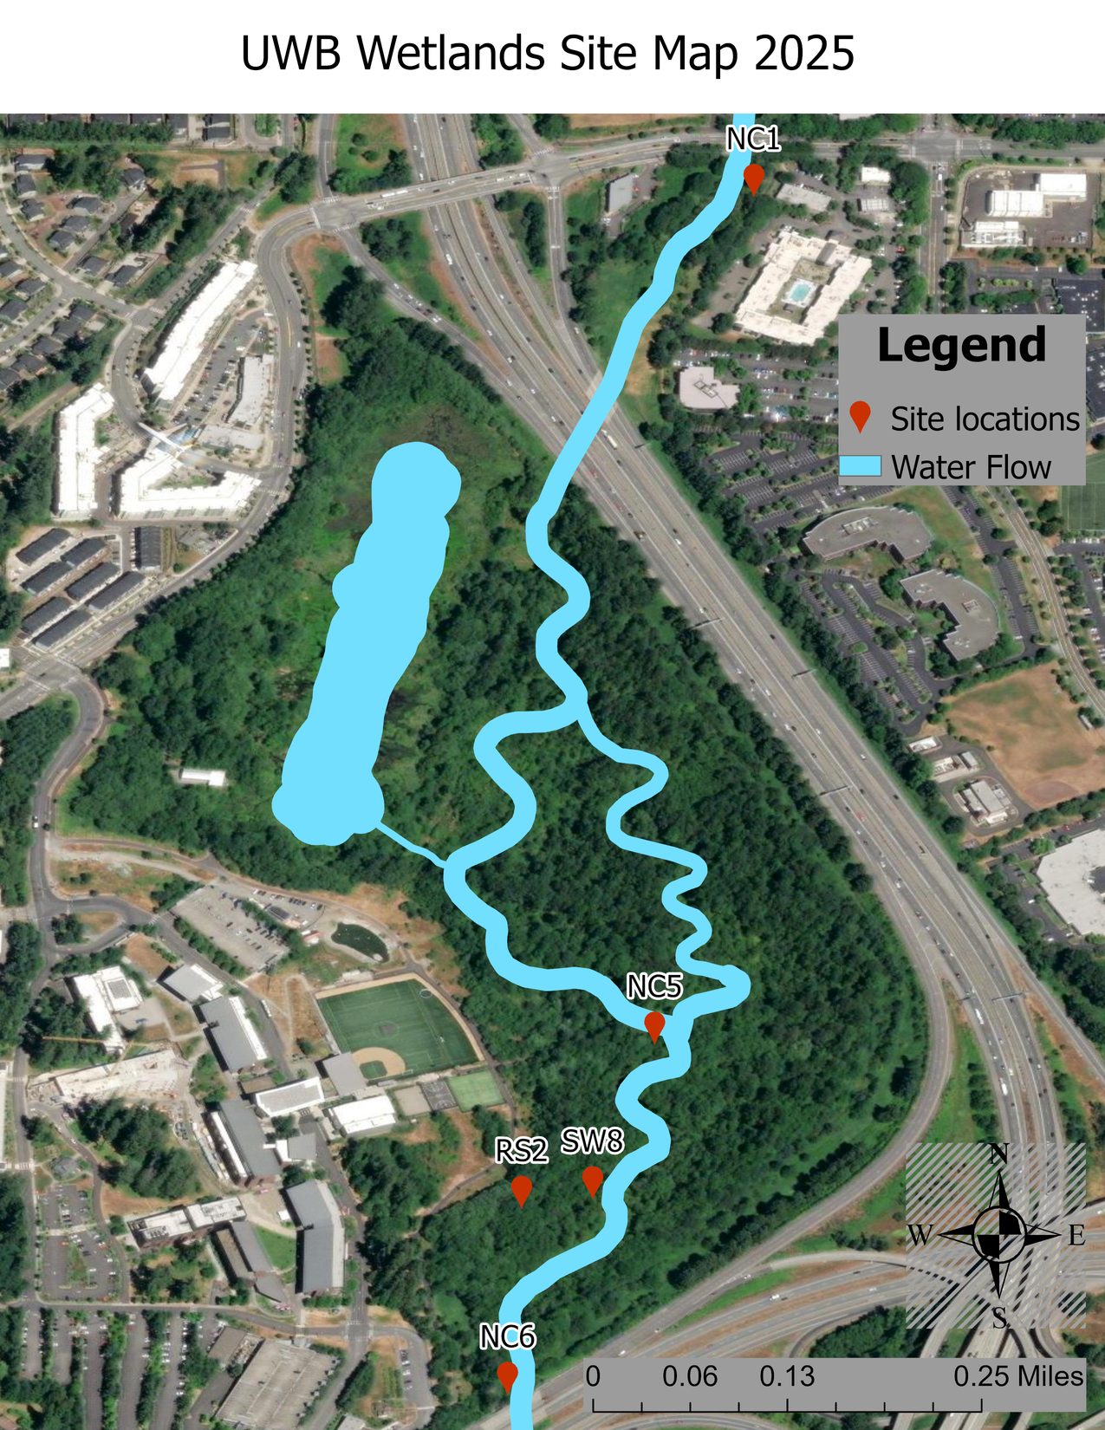
5 Site Locations at UWB
NC1– upstream of the wetland
NC5 – middle of wetland, downstream of the beaver dams and pond
RS2 – Pipe discharging runoff from the upper campus
SW8 – within the past crow roost boundary
NC6 – downstream, closest to the highway, lower boundary
Crows used to roost near cite SW8 and NC5
Acronym Definitions
RS = Runoff Swale
SW – Surface Water
NC – North Creek
Note: Water the runs off from the UWB campus will pass through RS2 and SW8
Disclaimer: The sites selected included past water quality data for comparison.

Slide 4
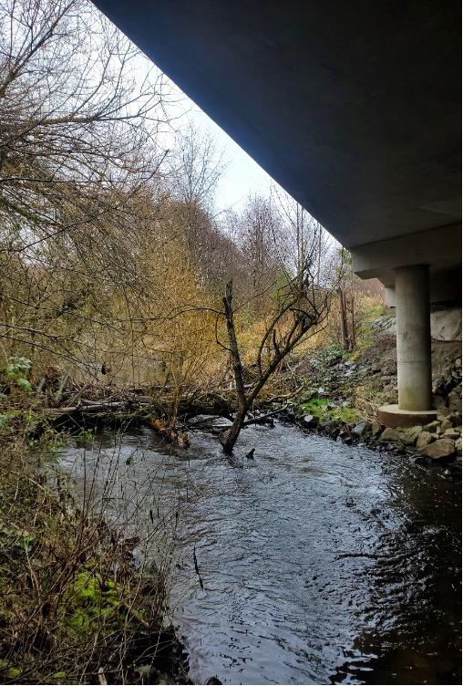
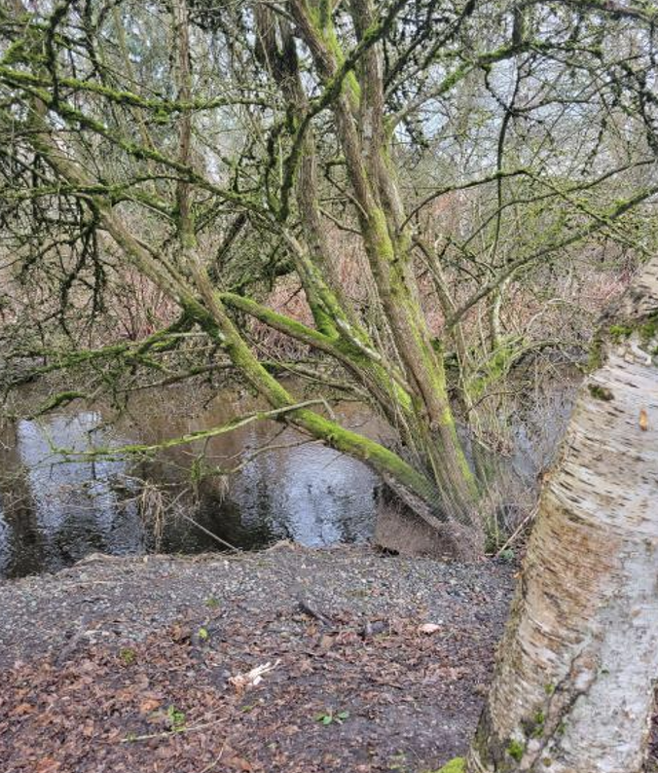
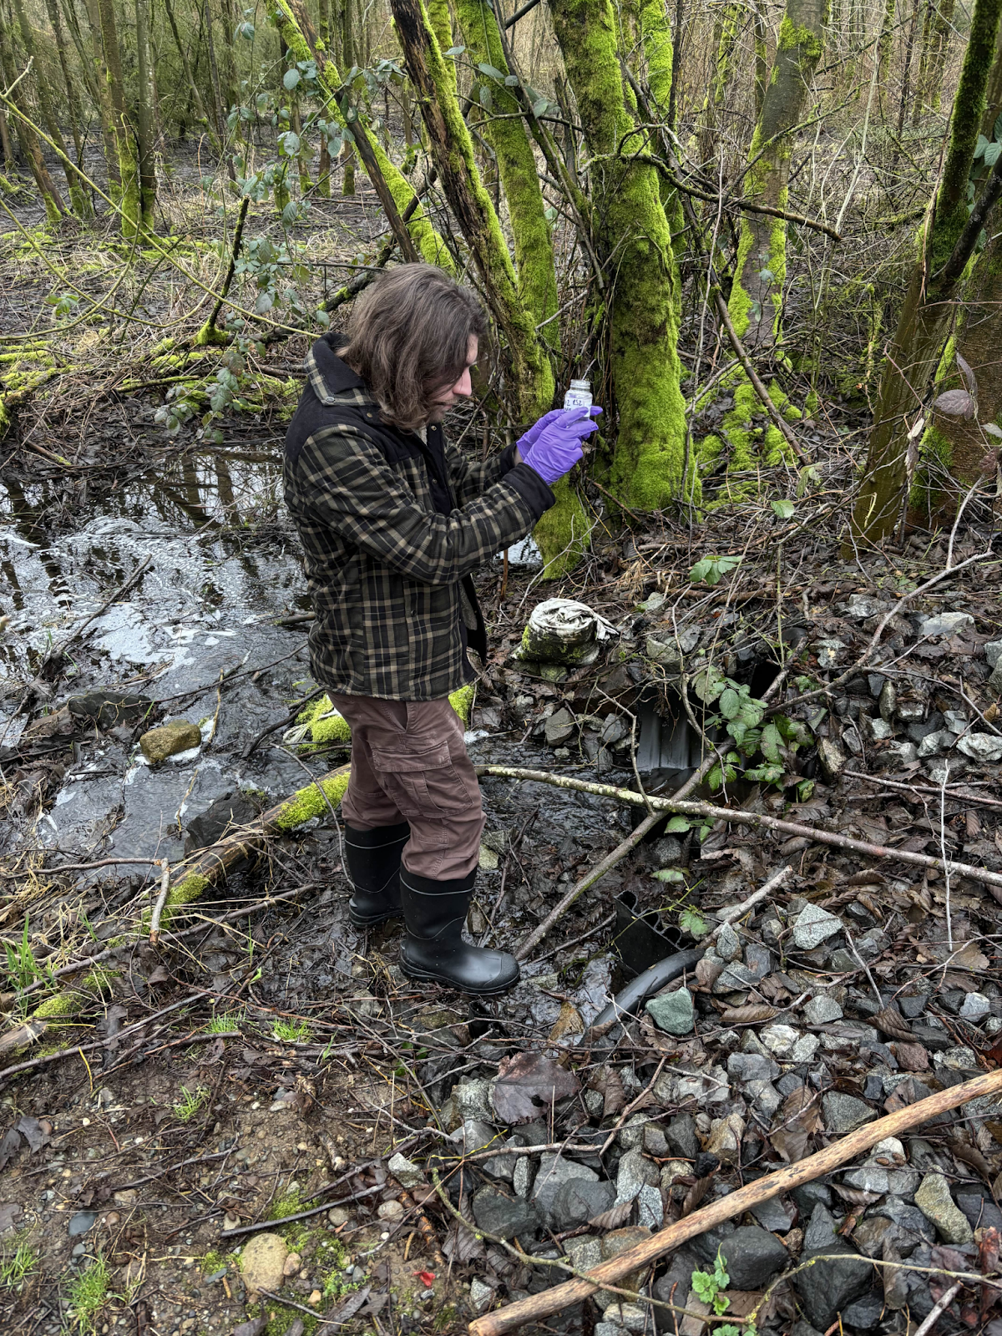
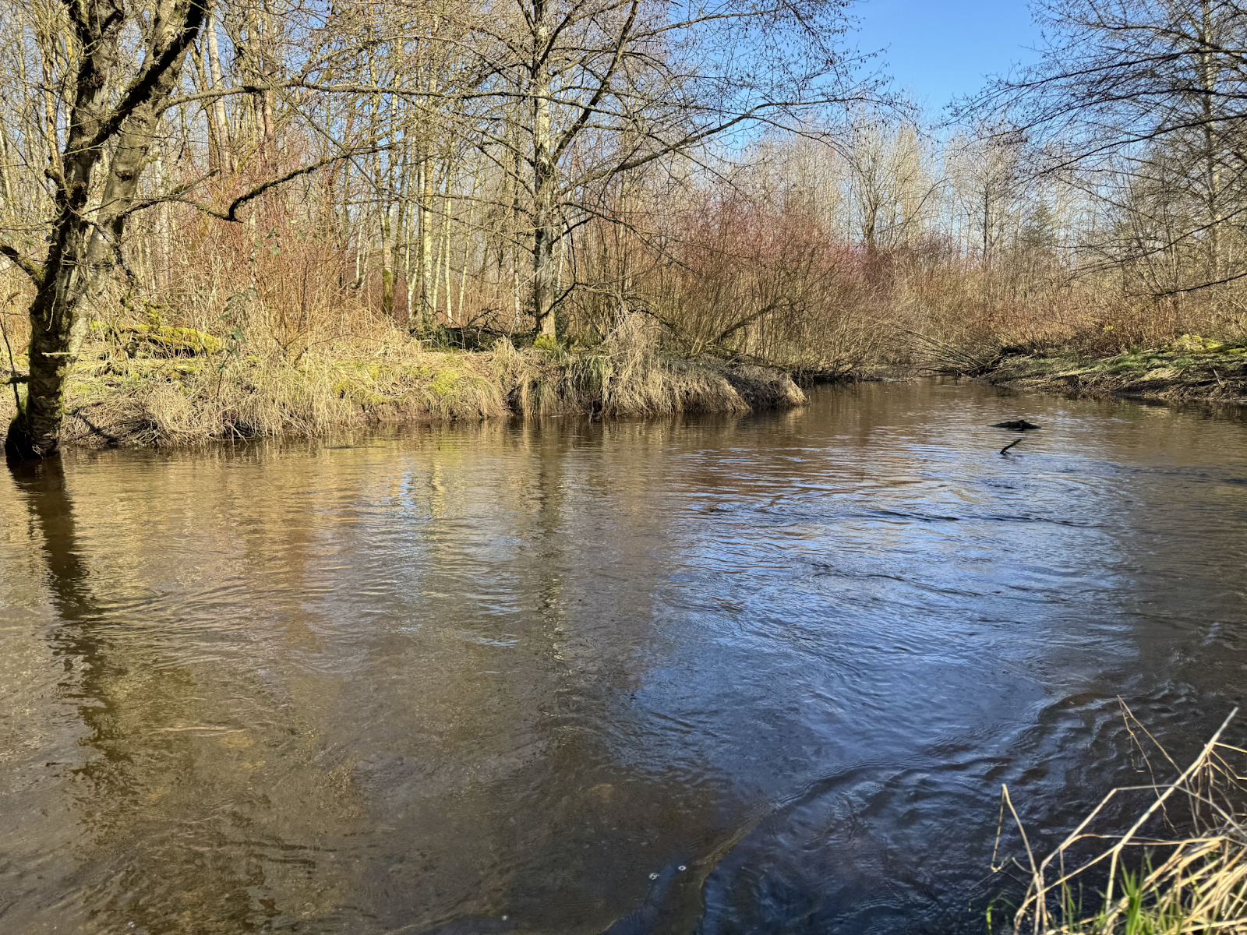
Sites
NC6
Credit: WI23 Group Gina Gesell
NC1
Credit: WI23 Group Gina Gesell
RS2
NC5

Slide 5
Hypothesis
Sites that are more downstream will have higher levels of fecal coliform.
Fecal coliform levels will have declined over time, as the UWB Wetlands has higher amount of vegetation.

Slide 6
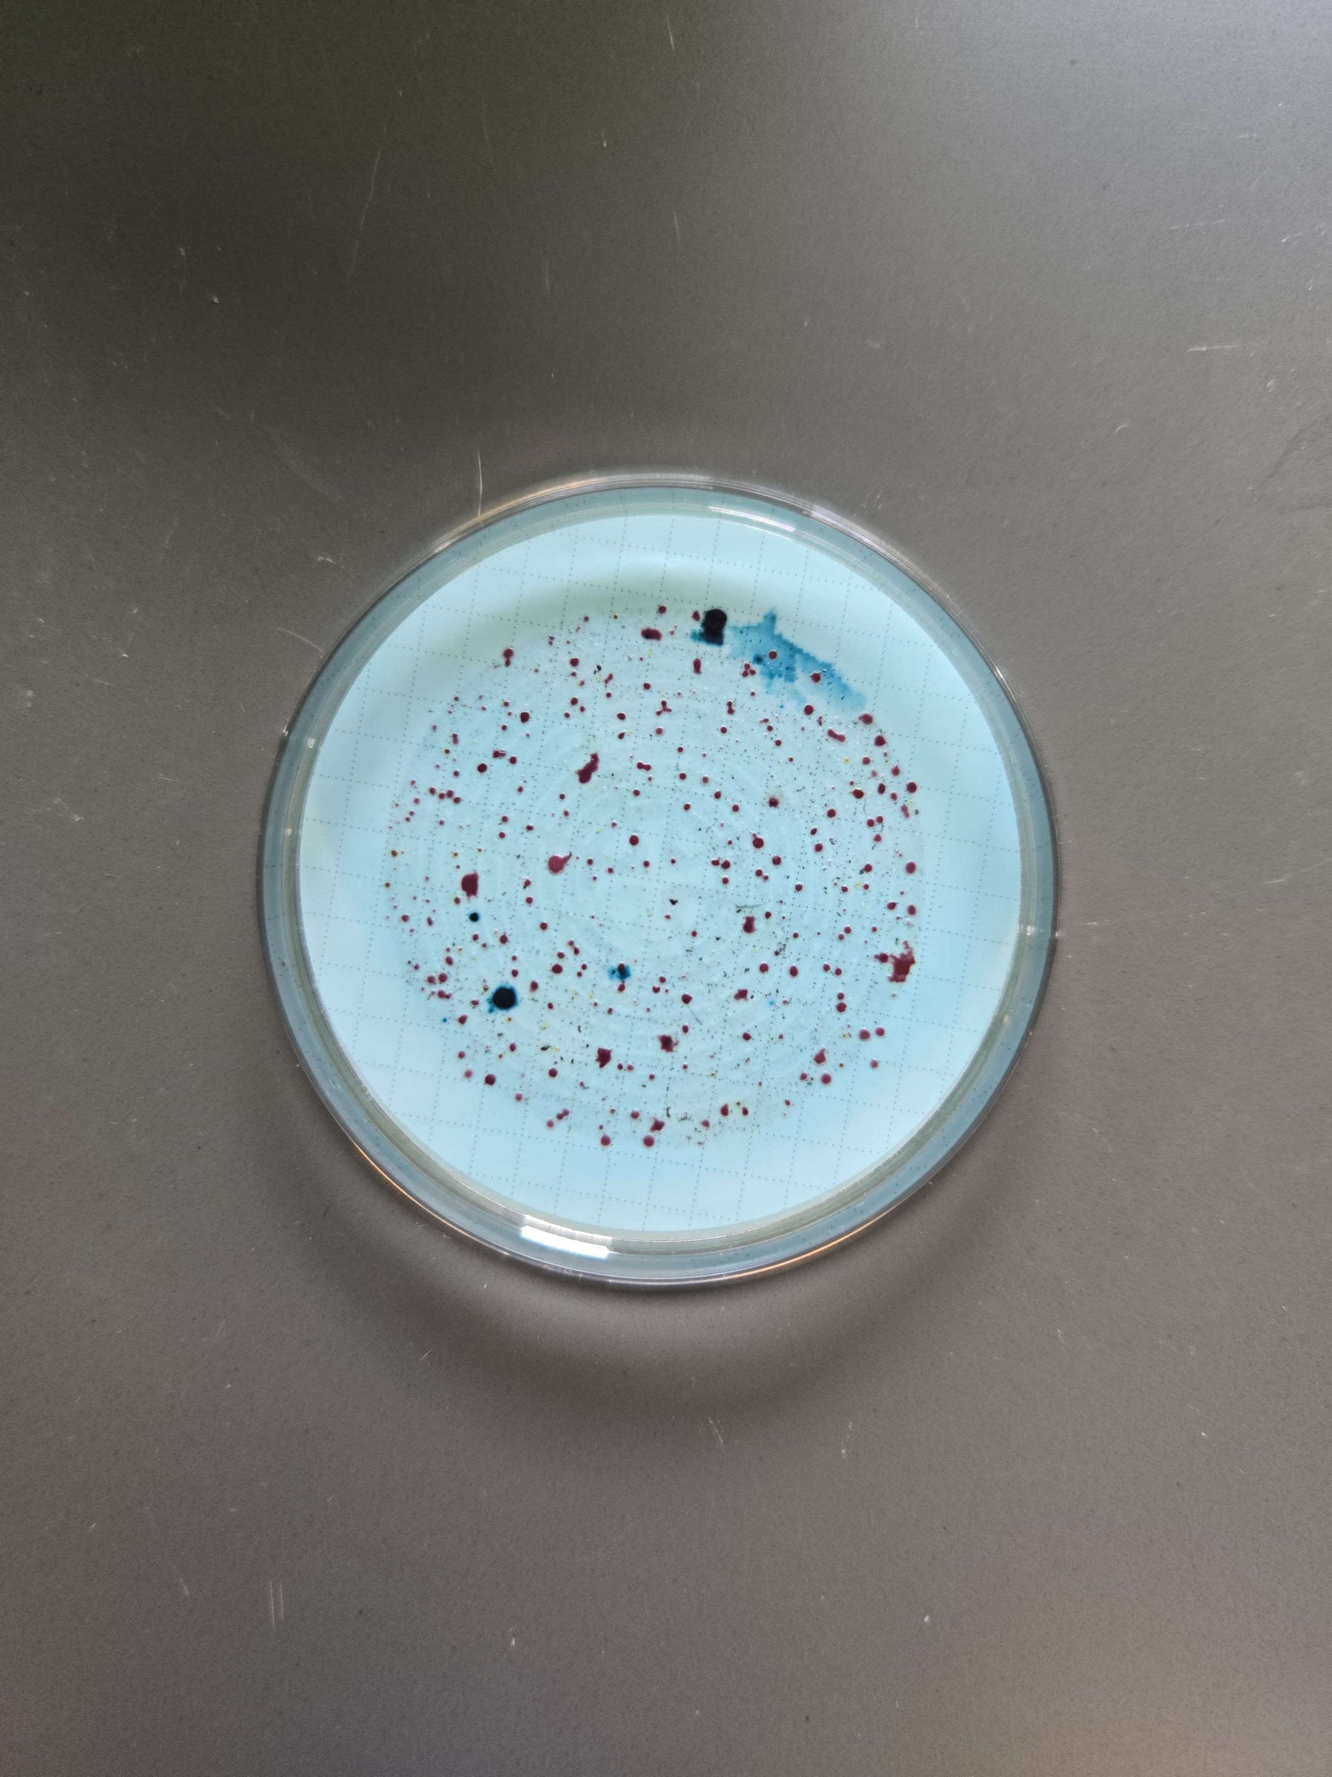
Methods
Use m-ColiBlue24 to check fecal coliform levels within the stream that runs through the UWB Wetlands.
Use EPA Approved Method 10029
(Red) Other Fecal Coliform
Bacteria Colonies
(Blue) E. Coli
Bacteria Colonies

Slide 7
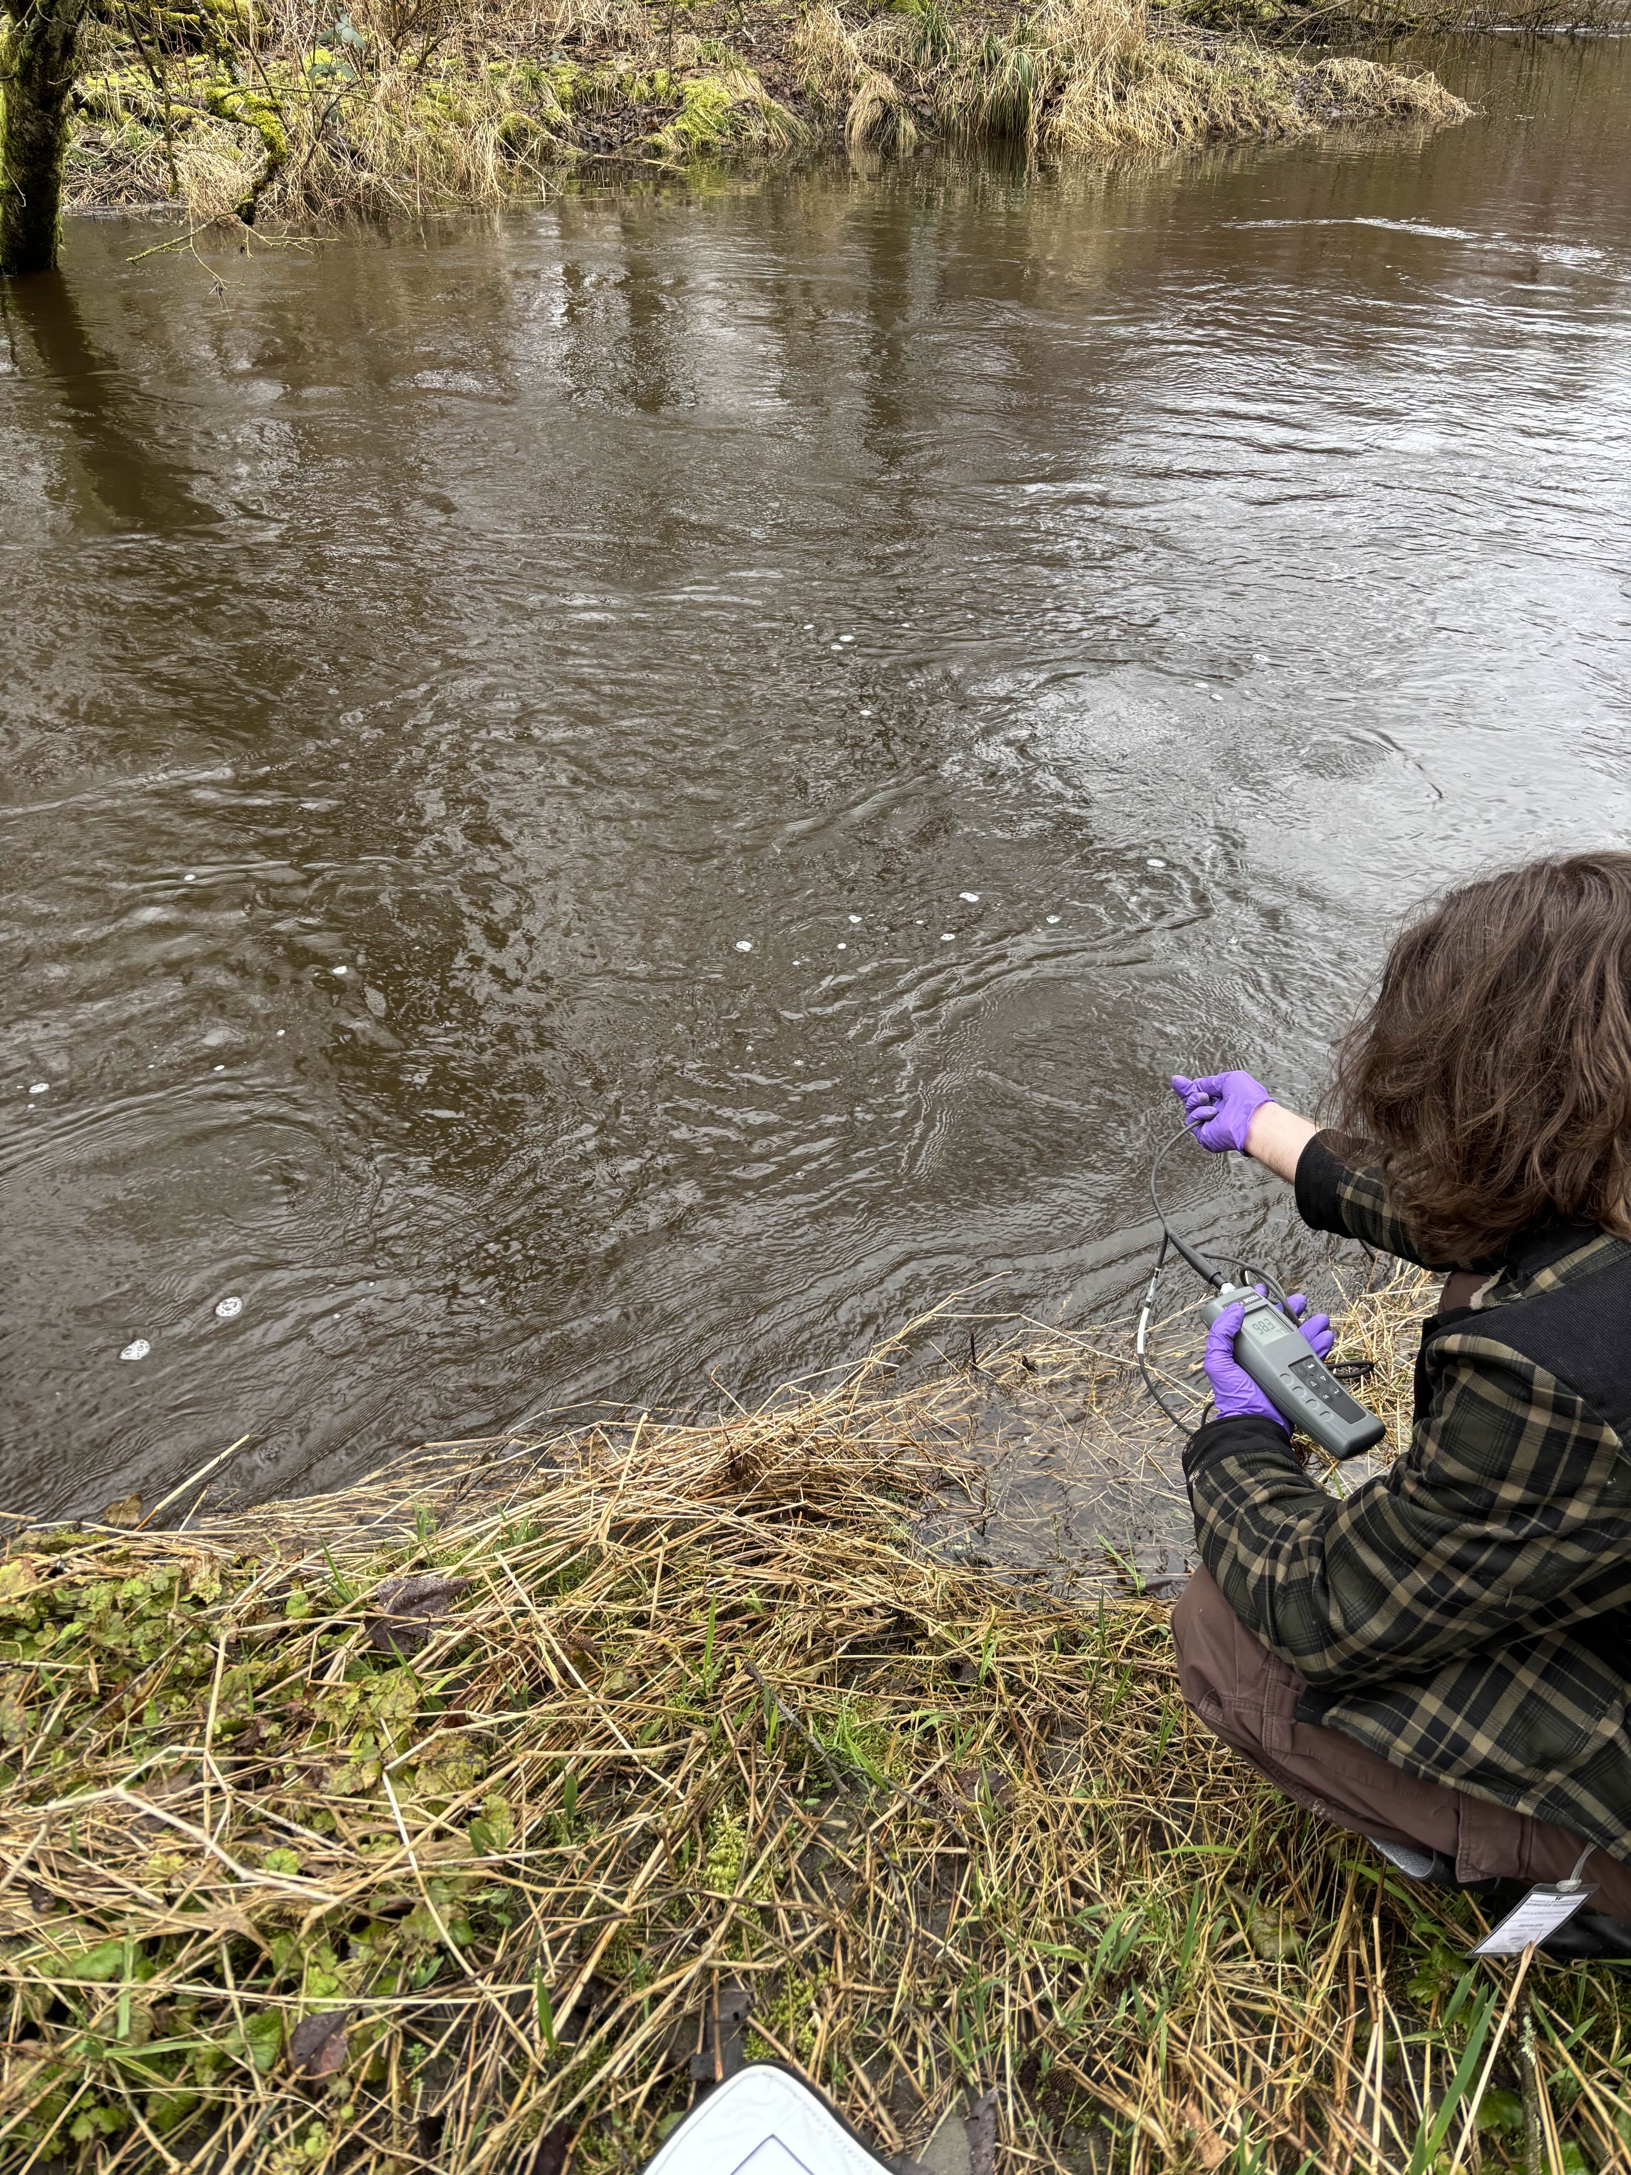
Methods
Conduct investigation by splitting into two teams; lab team and a field sampling team.
Construct data sheet and create graphics to explain the data results.

Slide 8
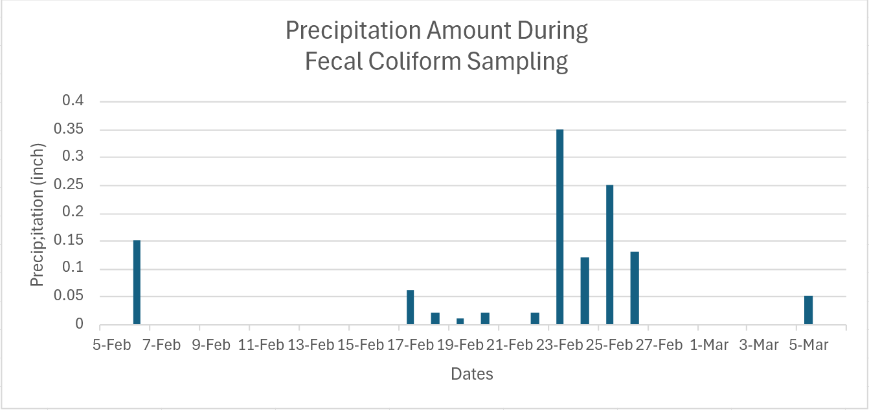
Weather Effects of our Sampling
Big rainfall after 2 weeks of mild to no rain
Our sampling period was between 2/25 and 3/4
Data Source: https://www.wunderground.com/history/monthly/us/wa/everett/KPAE/date/2025-2

Slide 9
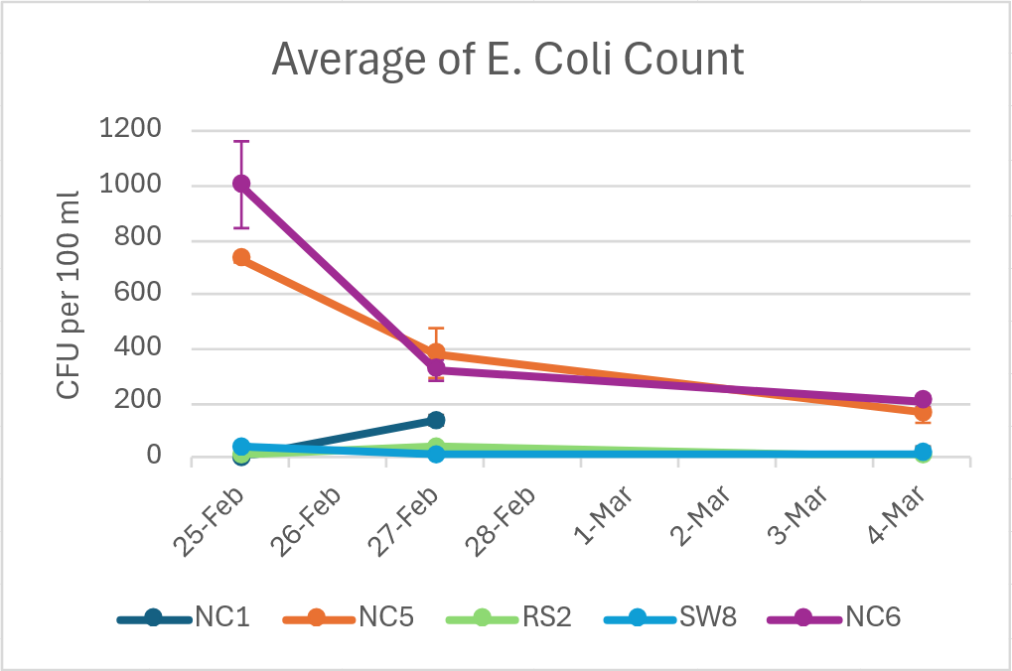
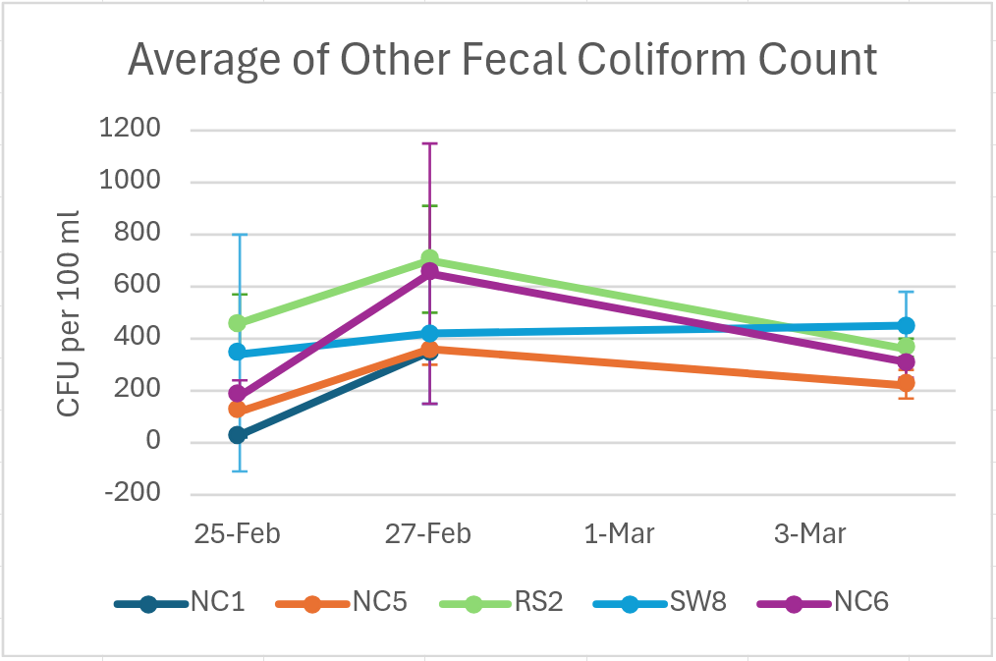
All Sites Overview of Fecal Coliform Levels
Higher E. Coli counts appear at sites NC5 and NC6

Slide 10
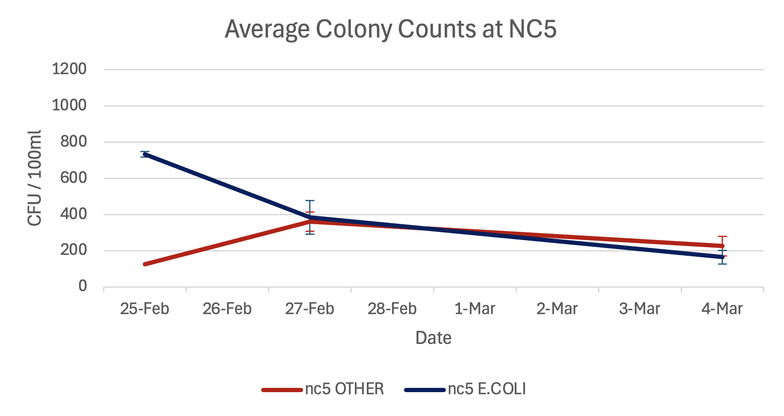
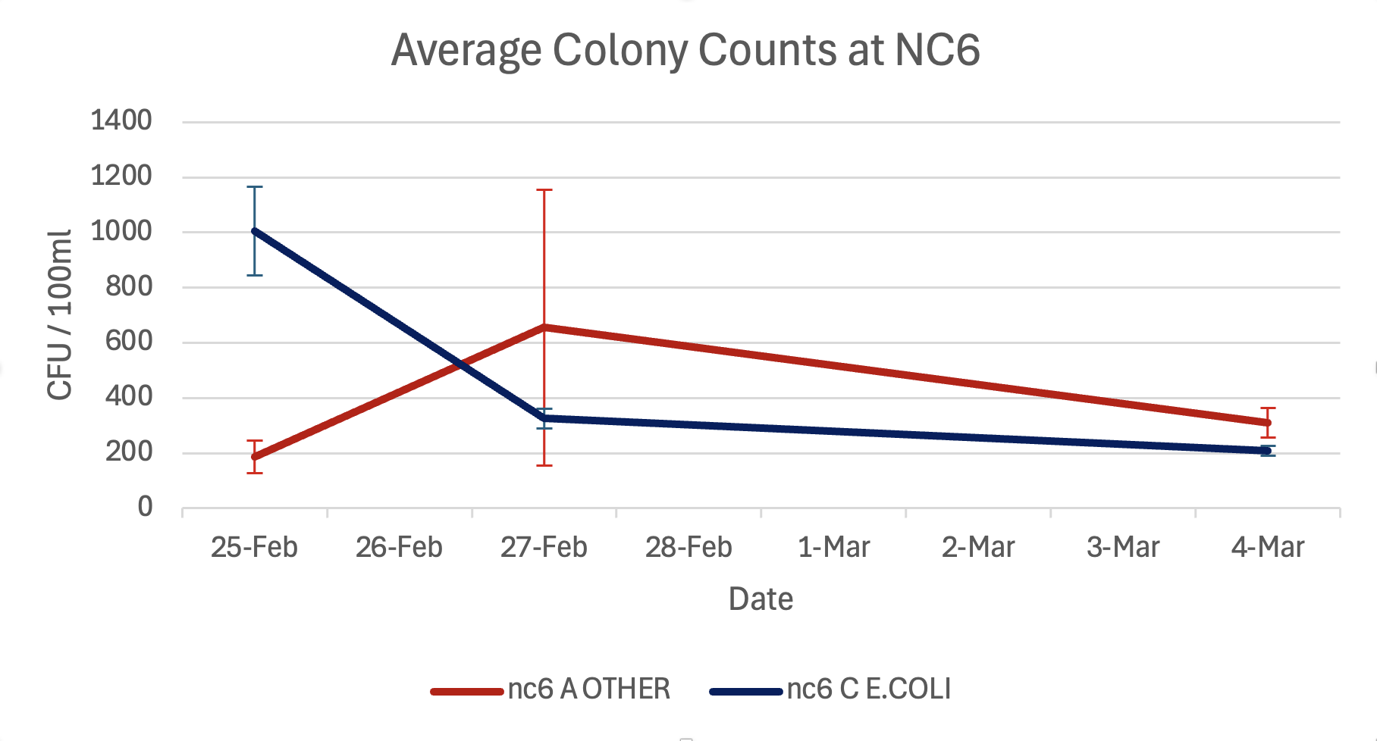
Fecal Coliform Levels at NC5 and NC6

Slide 11
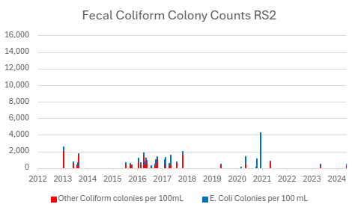
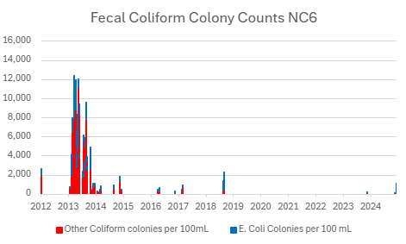
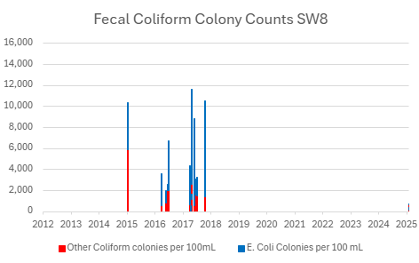
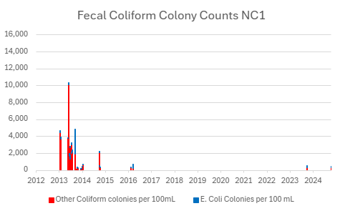
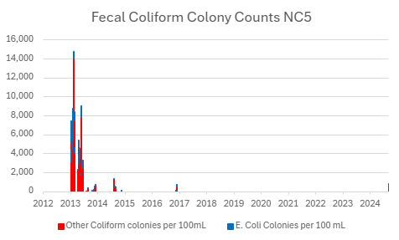
Past Data Comparison - Fecal Coliform
Past data shows no noticeable pattern or trend.
However, we can see that the past data has historically been much higher than what we are seeing present in these UWB wetland sites.
(shown in the charts)
May suggest some plausibility to our hypothesis
Sources for past data: UWB water quality database 2025 Excel spreadsheet – sheets: campus 2013-2022, Wetland 2013-2025, and NC1 vs NC6

Slide 12
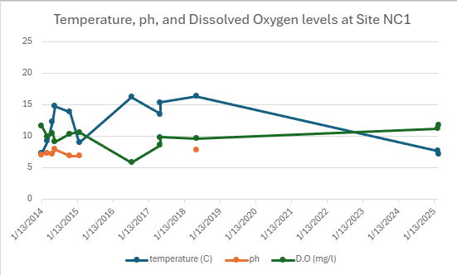
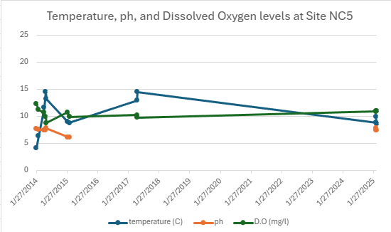
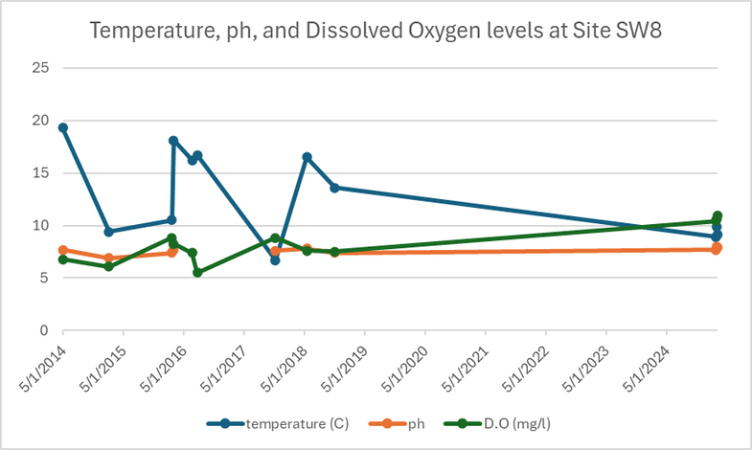
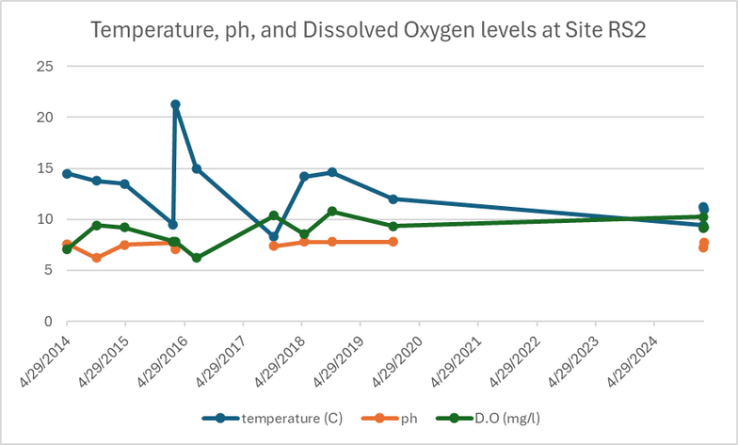
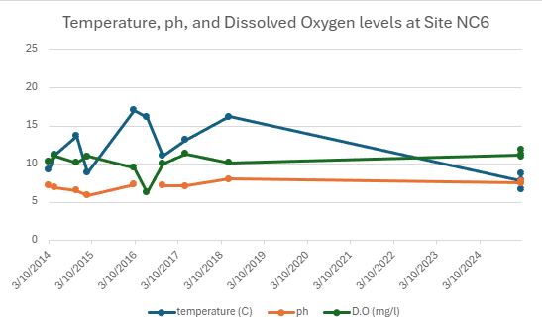
Past Data Comparison - Temperature, ph, Dissolved Oxygen,
- Limitations of this comparison includes a lack data between 2019 and 2024, making it hard to get a wholistic image.
- With lower temperatures, dissolved oxygen rises. This tells us that the percent saturation of oxygen is relatively constant.
pH stays relatively constant throughout the timeline.
- Generally, SW8 and RS2 had lower dissolved oxygen compared to other sites.
Sources for past data: UWB water quality database 2025 Excel spreadsheet – sheets: campus 2013-2022, Wetland 2013-2025, and NC1 vs NC6

Slide 13
Conclusion
There is less fecal coliform overall compared to data from 10 years ago.
Possibly from the migration of crows or increase of vegetation in the UWB Wetlands but further research required.
Our data seems consistent enough to draw conclusions from.

Slide 14
Where could we take this research next?
Collect samplings across different seasons to see how bacteria levels change throughout the year. Bacteria can thrive in warmer months, and heavy Fall/Winter rains wash more contaminants into the wetlands
Determine if the bacteria originated from birds, beavers, other wildlife, or potentially human sources and tracing their source

Slide 15
Acknowledgements
Professor Turner for guiding the research project
Past students of BES 303 for providing the data within the Excel spreadsheet UWB water quality database
Precipitation data of Paine Field Airport from https://www.wunderground.com/history/monthly/us/wa/everett/KPAE/date/2025-2
Site images by Winter 2023 Group Gina Gessell
Turner,R.(2025). UWB Water Quality Database 2025 UWB Water Quality Database_2025-1.xlsx

Slide 16
Thank you!
Questions?

